Slide 1
Lecture VI
LASER

Slide 2
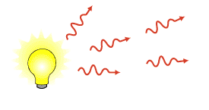
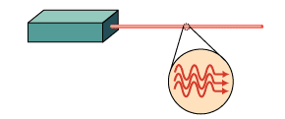
Light Amplification by Stimulated Emission of Radiation
Spontaneous emission
Stimulated emission

Slide 3
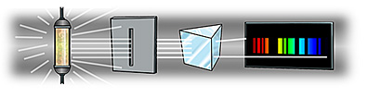
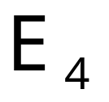
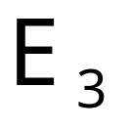
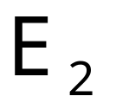
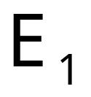
Energy level diagram
The possible energies which electrons in the atom can have is depicted in an energy level diagram.

Slide 4
The operation of the Laser
In 1958, Charles Townes and Arthur Schawlow theorized about a visible laser, an invention that would use infrared and/or visible spectrum light.
Light Amplification by Stimulated Emission of Radiation- (LASER).
Properties of Lasers
  Produce monochromatic light of extremely high intensity.

Slide 5
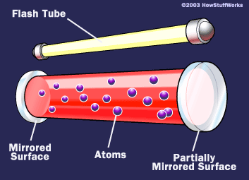
The operation of the Laser

Slide 6
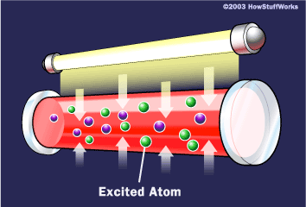
The operation of the Laser
(Pumping the Laser)

Slide 7
The operation of the Laser
absorption

Slide 8
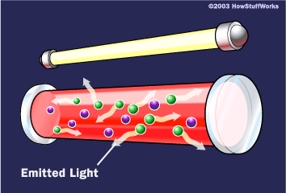
The operation of the Laser
Spontaneous emission

Slide 9
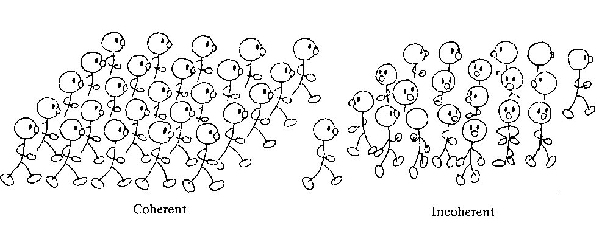
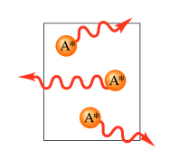
The operation of the Laser
Spontaneous emission
Incoherent light
Accidental direction

Slide 10
The operation of the Laser

Slide 11
The operation of the Laser
Stimulated emission

Slide 12
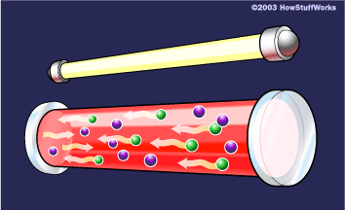
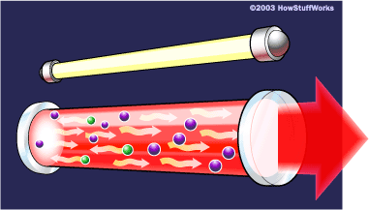
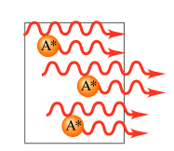

The operation of the Laser
Light: Coherent, polarized
The stimulating and emitted photons have the same:
frequency
phase
direction

Slide 13
Two level system
E₂
E₂
hν
hν
hν
hν =E₂-E₁
E₁
E₁
absorption
Spontaneous emission
Stimulated emission

Slide 14
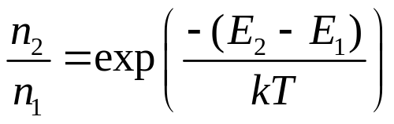
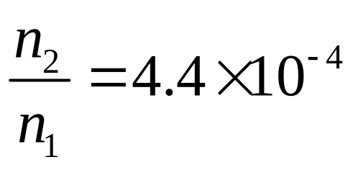
Boltzmann’s equation
E₂
E₁
example: T=3000 K E₂-E₁=2.0 eV
n₁ - the number of electrons of energy E₁
n₂ - the number of electrons of energy E₂

Slide 15

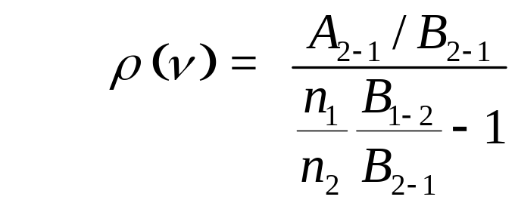
Einstein’s coefficients
Probability of stimulated absorption R₁₋₂
R₁₋₂ = ρ (ν) B₁₋₂
Probability of stimulated and spontaneous emission :
R₂₋₁ = ρ (ν) B₂₋₁ + A₂₋₁
assumption: n₁ atoms of energy ε ₁ and n₂ atoms of energy ε ₂ are in thermal equilibrium at temperature T with the radiation of spectral density ρ (ν):
n₁ R₁₋₂ = n₂ R₂₋₁ n₁ρ (ν) B₁₋₂ = n₂ (ρ (ν) B₂₋₁ + A₂₋₁)
E₂
E₁

Slide 16
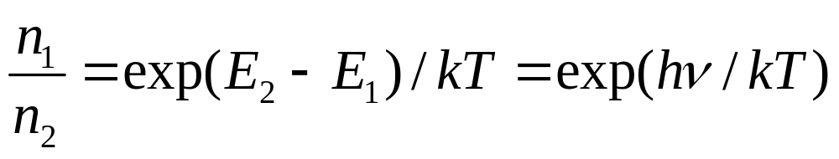
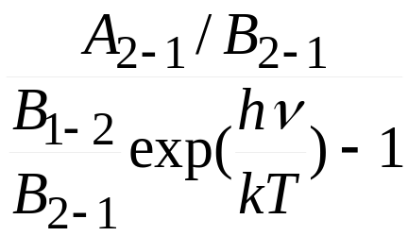
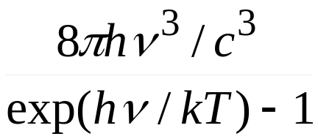
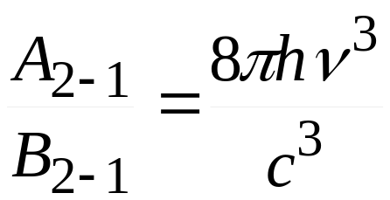
According to Boltzman statistics:
ρ (ν) = =
Planck’s law
B₁₋₂/B₂₋₁ = 1

Slide 17
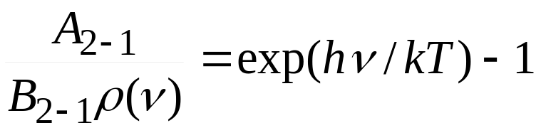
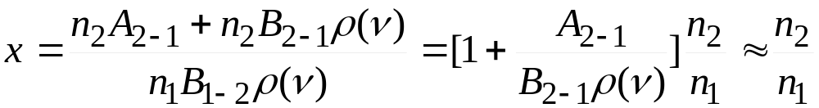
The probability of spontaneous emission A₂₋₁ /the probability of stimulated emission B₂₋₁ρ(ν ):
Visible photons, energy: 1.6eV – 3.1eV.
kT at 300K ~ 0.025eV.
stimulated emission dominates solely when hν /kT <<1!
(for microwaves: hν <0.0015eV)
The frequency of emission acts to the absorption:
if hν /kT <<1.
x~ n₂/n₁

Slide 18
Condition for the laser operation
E₂
E₁
If n₁ > n₂
radiation is mostly absorbed
spontaneous radiation dominates.
if n₂ >> n₁ - population inversion
most atoms occupy level E2, weak absorption
stimulated emission prevails
light is amplified
Necessary condition:
population inversion

Slide 19
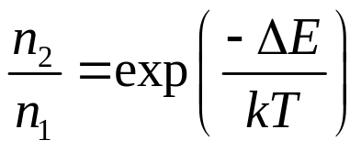
How to realize the population inversion?
Thermal excitation:
E₂
E₁
impossible.
The system has to be „pumped”
Optically,
electrically.

Slide 20
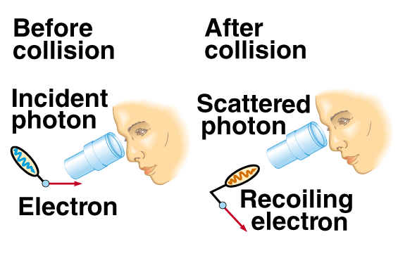
The Uncertainty Principle
Measurement disturbes the system

Slide 21
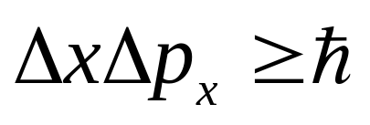
The Uncertainty Principle
Classical physics
  Measurement uncertainty is due to limitations of the measurement apparatus
  There is no limit in principle to how accurate a measurement can be made
Quantum Mechanics
  There is a fundamental limit to the accuracy of a measurement determined by the Heisenberg uncertainty principle
  If a measurement of position is made with precision Δx and a simultaneous measurement of linear momentum is made with precision Δp, then the product of the two uncertainties can never be less than h/2π

Slide 22
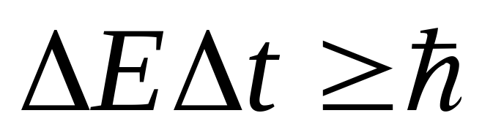
The Uncertainty Principle
Virtual particles: created due to the UP

Slide 23
The laser operation
Three level laser
E₃
Fast transition
E₂
Laser action
E₁
1→3 pumping
spontaneous emission 3 →2.
state 2 is a metastable state
population inversion between states 2 and 1.
stimulated emission between 2 i 1.

Slide 24

E₃
Fast transition
The laser operation
E₂
lasing
E₁
- optical pumping - occupation of E3 of a short life time,
10-8s. It is a band, the metastable and ground states are narrow :
- electrons are collected on E2: population inversion
- stimulated emission (one photon emitted spontaneously starts the stimulated radiation )
- Beam of photons moves normally to the mirrors – standing wave.

Slide 25
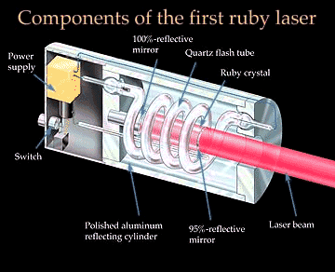
ruby laser
discovered in 60-ies of the XX century.
ruby (Al₂O₃) monocrystal, Cr doped.

Slide 26
Ruby laser
Lasing from the Cr³⁺.
three level laser
Al₂O₃
optical pumping: 510-600nm and 360-450nm.
fast transition on ²E.
lasing: ²E on ⁴A_{2,}
694nm
Cr⁺
⁴T₁
²T₂
Energy
rapid decay
⁴T₂
²E
LASING
⁴A₂

Slide 27
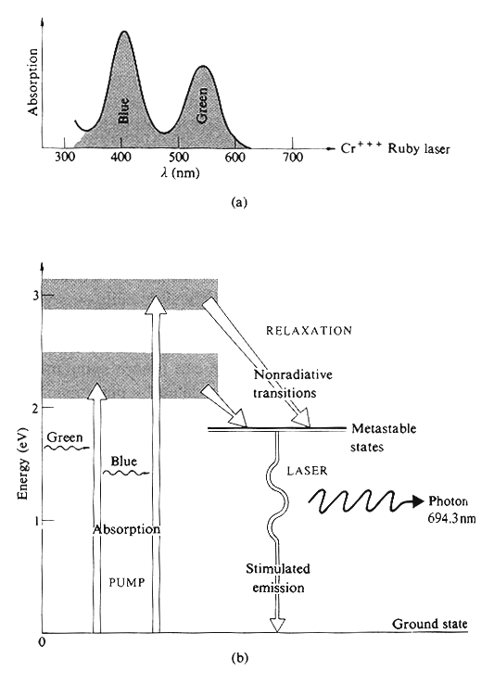
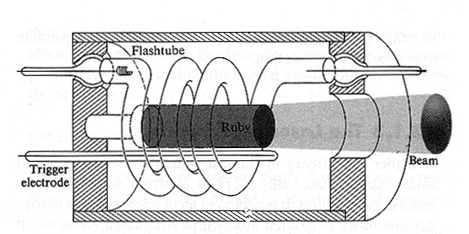
Ruby laser
First laser: Ted Maiman
Hughes Research Labs
1960

